Slide 1
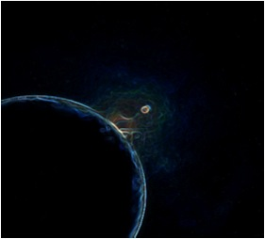
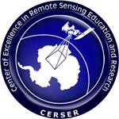
Remote Sensing
Brought to you by Kalyx McDonald
Created by Kalyx McDonald and Courtney Farmer
Notes:
*all pictures are royalty free on this slide*

Slide 2
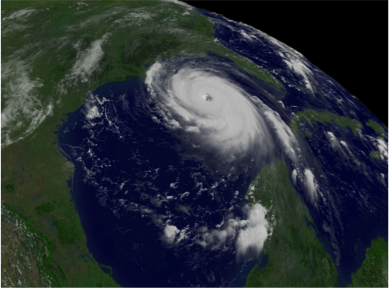
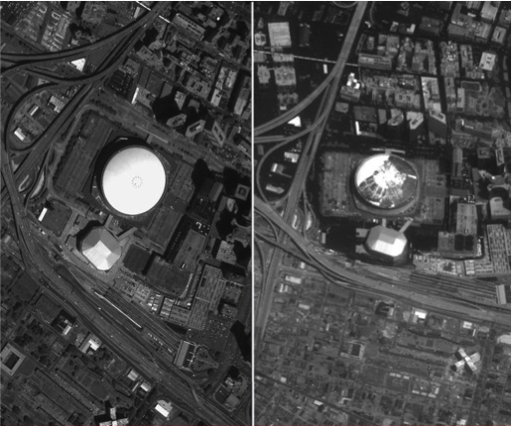
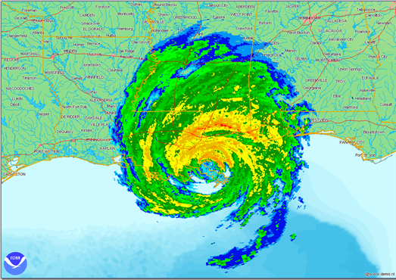
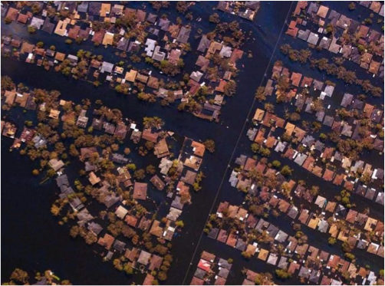
Did you know this was remote sensing?
1
2
3
Notes:
In 2005 a tropical storm turned into a category 5 hurricane known as hurricane katrina. The images you see are pictures of New Orleans from a satellite and aircraft. This natural disaster killing about 1400 people is an event no one will forget. With the use of remote sensing technology and sensors,we can detect and prevent future events to come.

Slide 3
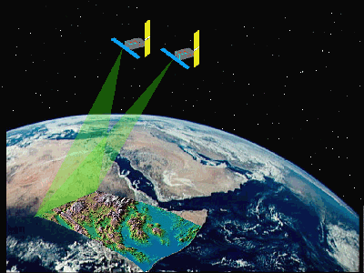
Remote Sensing
The art and science of obtaining information from an electromagnetic radiation signature without being in direct physical contact.
4
Notes:
So now that you've seen an example, what exactly is remote sensing?
It's when you obtain information from an electromagnetic radiation signature without actually being there.
*all pictures are royalty free on this slide*

Slide 4
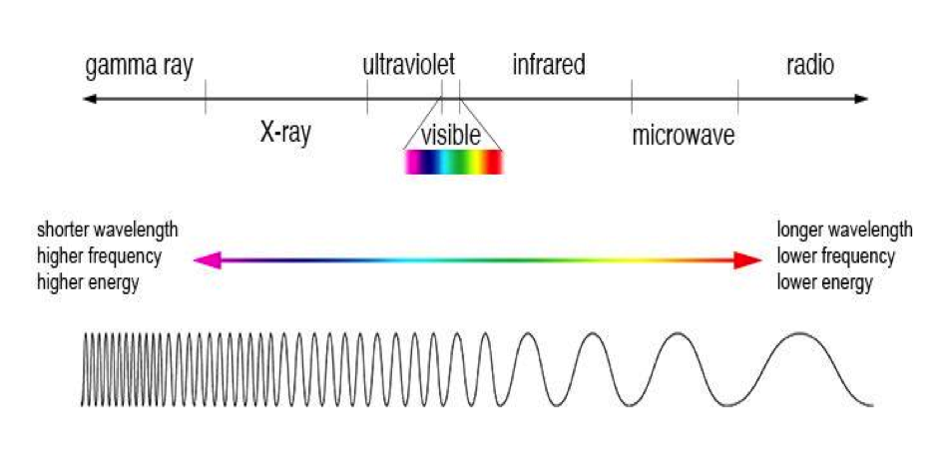
Electromagnetic Radiation
5
Notes:
electromagnetic radiation ranges 7 possible frequencies on the electromagnetic spectrum.
The first being gamma ray which has faster & shorter wavelengths, to radio waves which are large but have a lower frequency.
Gamma Rays have greater energy and are produced by violent events like supernova explosions.
X-rays Can be hot gases in the universe but are mainly used in hospitals.
next is Ultraviolet. the earth's ozone layer absorbs most of the incoming ultraviolet light from the sun. if not it could be very harmful to us.
visible is the only radiation detected by human eyesight.
Infrared is emitted by any object that has a temperature and can be divided into 3 parts. far,mid and near. that means some infrared wavelengths are better suited for studying certain objects than others.
Microwaves are extremely high frequency radio waves.
and Radio carries information through frequencies. examples are the tv, and your cellphone.

Slide 5
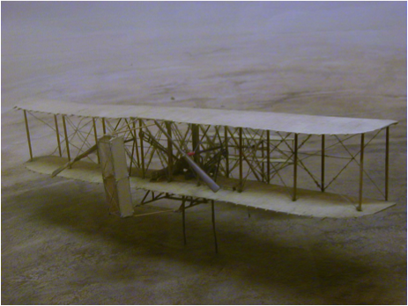
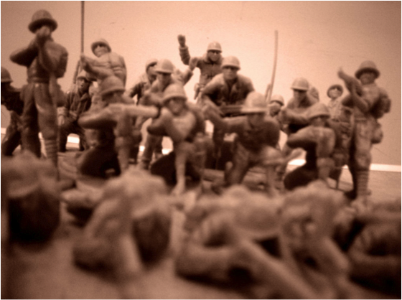
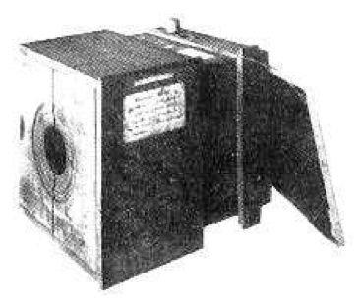
Camera, Airplanes & War
First flight (1903) - Wright Brothers
World War 1 - 1914
First photographic image (1826) -
Joseph Nicephore
Notes:
*all pictures are royalty free on this slide*
As paraphrased by Kofi Annan, Knowledge is power and Information is liberating . The first camera was invented in 1826 while the first flight in 1903. together, in WW1 these 2 technologies were the beginning of remote sensing. They were used to locate troops along with enemy grounds.

Slide 6
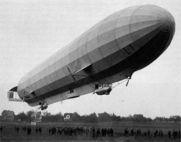
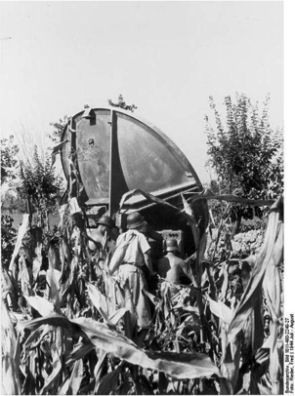
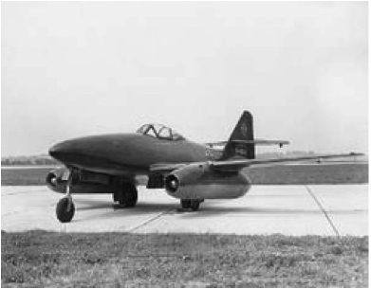
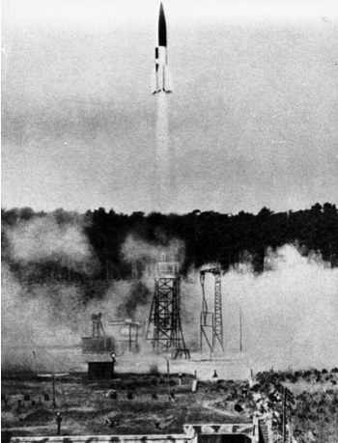
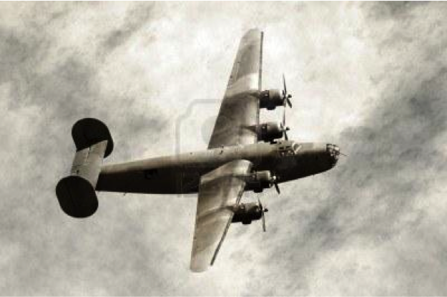
World War ll
21
16
Notes:
*all royalty free except two and it is sighted*
During WW2, both sensors and platform technology improved. Platforms such as the zeppelin, v2 rocket and the M.E 262 jet allowed
increased range, payload and speed of aircraft. Sensing technology improved in both image resolution and a new sensor type called the radar.
An early radar system first detected the raid on pear harbor in hawaii. However, the report was ignored because it was an unproven technology.

Slide 7
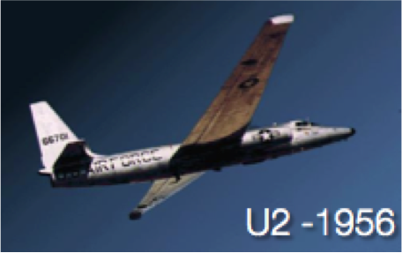
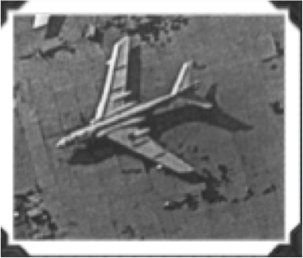
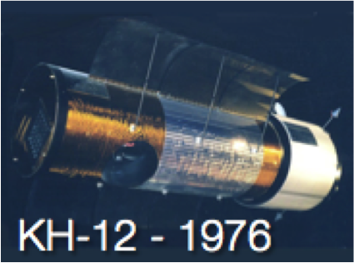
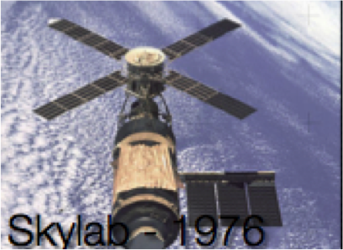
Space Race & Cold War
19
20
17
18
The term "Remote Sensing" introduced to the Office of Naval Research - 1960
Notes:
Platform technologies included the U2 spy plane, KH-12 satellite and skylab. During this time in 1960 the term remote sensing was introduced by the office of navel research.

Slide 8
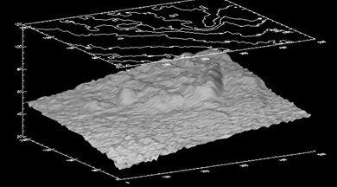
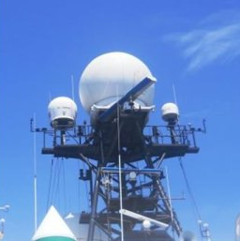
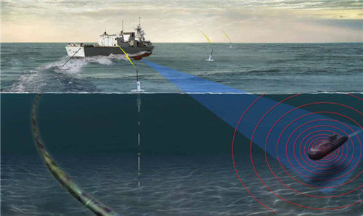
Active Sensor6
Provide their own source of energy
Radar
Lidar
Sonar
11
22
6
Notes:
Remote sensors fall into 2 categories. Active and passive. Active sensors provide their own source of illumination.
Examples are the radar which is used for speed detection, lidar for ground detection and sonar to find ships and submarines.

Slide 9
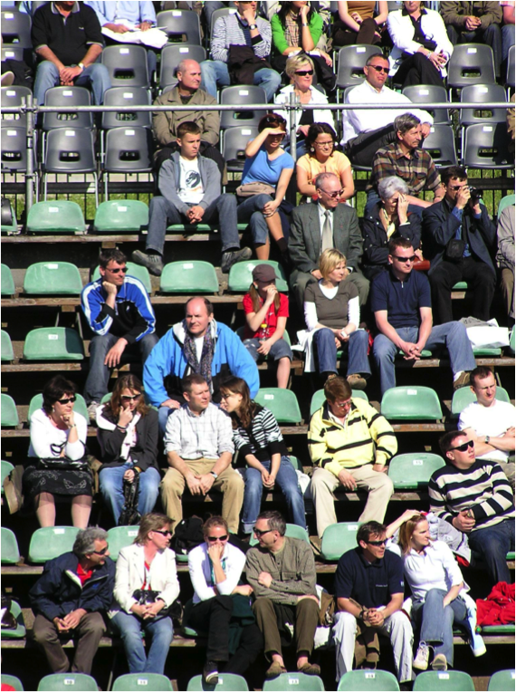
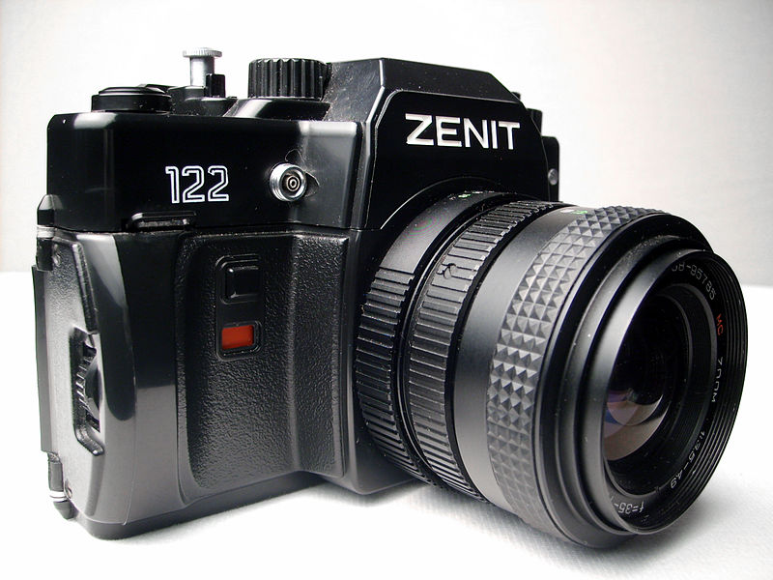
Passive Sensor6
Measures naturally available energy
Human eye
Camera
Microwave Radiometer
Notes:
Passive sensors measure naturally available energy and Need an external energy source
the human eye will forever be a passive sensor as we observe more than over a thousand things per day and have different reactions.
Other examples include the camera and microwave radiometer
*all pictures are royalty free on this slide*

Slide 10
Image/Data Types of Resolution
Spatial
Spectral
Temporal
Radiometric
Notes:
In a sensor, there is more than just what you see. resolutions are often utilized for image interpretation. the 4 types are spatial, spectral, temporal & radiometric.
-------
1. The size of a pixel that is recorded in a raster image
2.The wavelength width of the different frequency bands recorded – usually, this is related to the number of frequency bands recorded by the platform.
3. The frequency of flyovers by the satellite or plane, and is only relevant in time-series studies or those requiring an averaged or mosaic image as in deforestation monitoring
4. The number of different intensities of radiation the sensor is able to distinguish.
--------

Slide 11
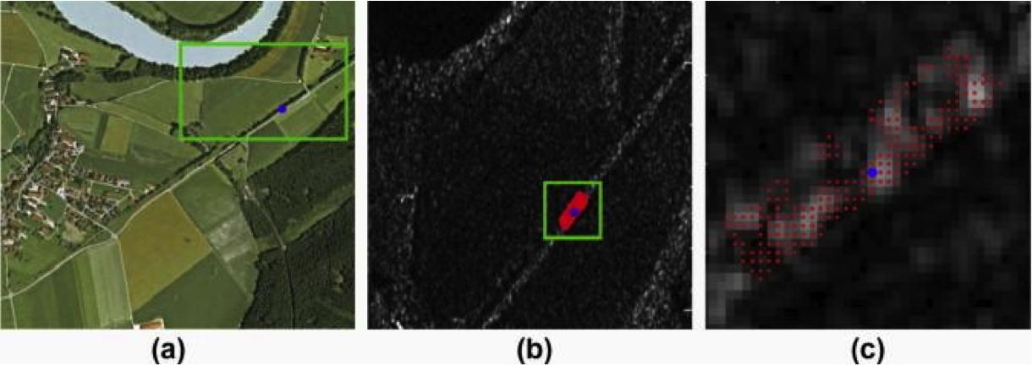
Spatial Resolution7
It describes the ability of any image forming device such as an optical or radio telescope, microscope, or camera to distinguish small details of an object thereby making it a major determinant of image resolution
8
Notes:
This means that as the visual gets closer various pixels are made up to distinguish a image.

Slide 12
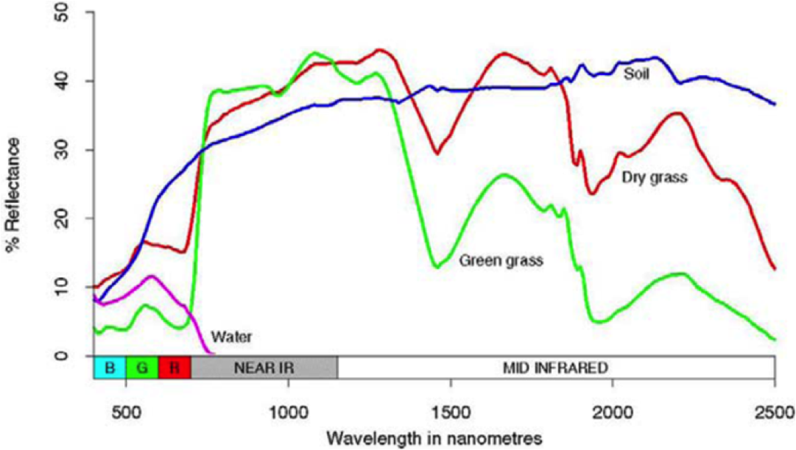
Spectral Resolution7
The measure of its ability to resolve features in the electromagnetic spectrum
9
Notes:
.By looking you can see the different sensitivities in comparing water, green grass, dry grass, and soil.a

Slide 13
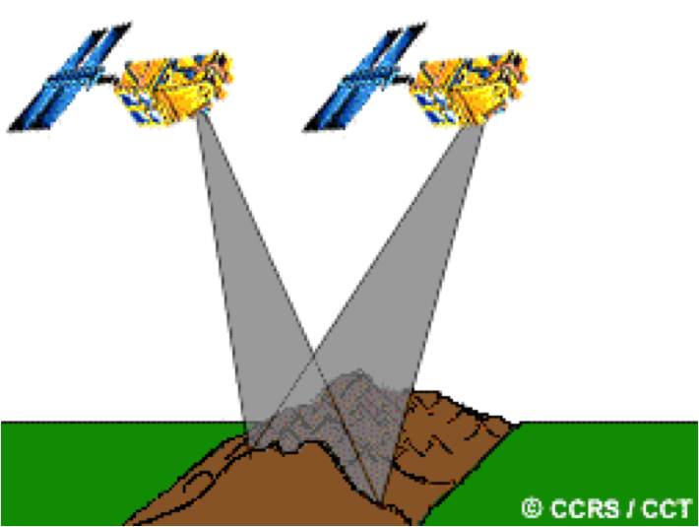
Temporal Resolution7
The frequency of flyovers by the satellite or plane, and is only relevant in time-series studies or those requiring an averaged or mosaic image as in deforestation monitoring.
10
Notes:
Temporal measures how often and revisited data is obtained from the same area. As you can see we are gaining the same view but from a different time.

Slide 14
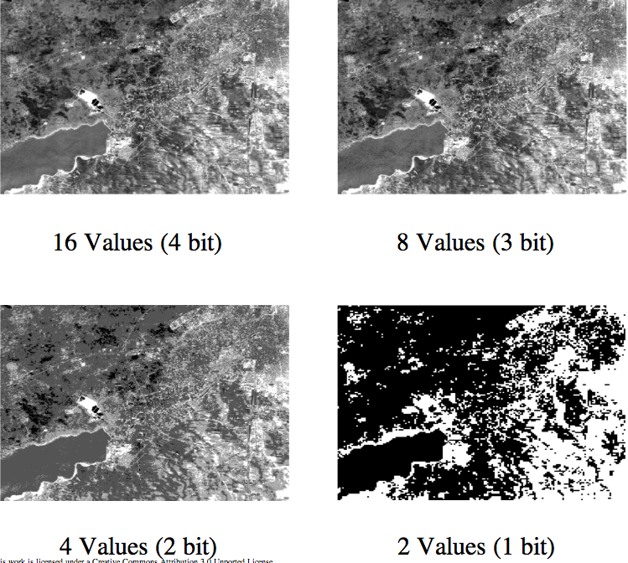
Radiometric Resolution7
Measures the sensitivity of a sensor to differences in the intensity of the radiation measured.
Notes:
In this example we have 4 images of different intensities the sensor is able to distinguish.

Slide 15
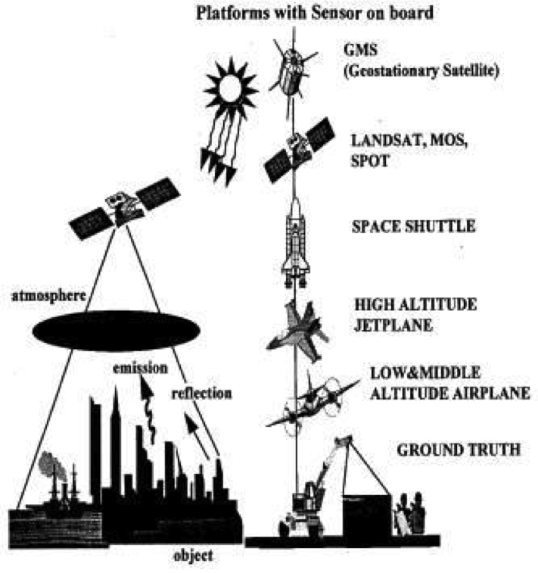
Platforms
Any medium that holds a sensory item.
Satellite (Telemetry)
Balloons
Airplane
Rocket
The Human Body
15
Notes:
Platforms are any object that holds a sensor. In this example we see several platforms with sensors already on them and their order of intensity

Slide 16
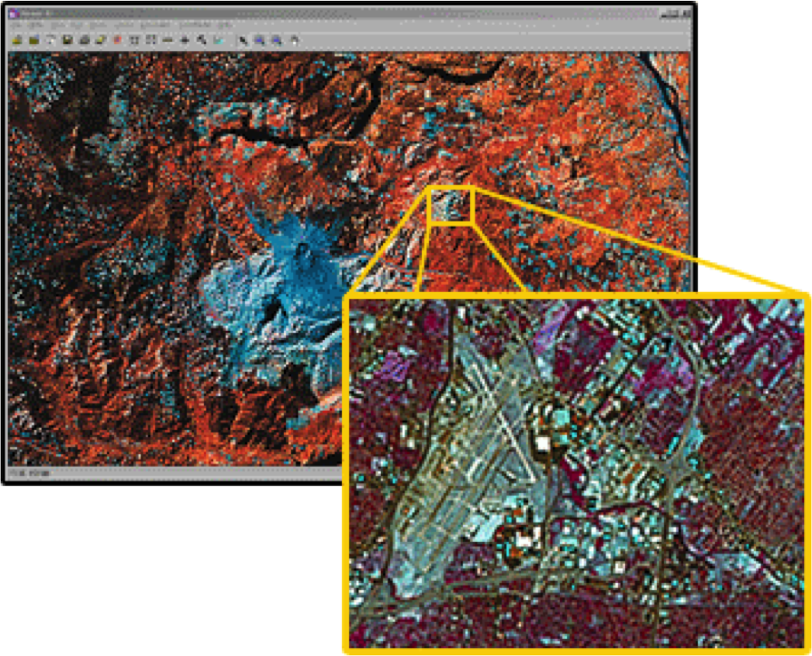
Research Areas: Classification
12
Land-cover Classification
Notes:
Finally, we have Remote research areas. These distinct features make up many uses for remote sensing.
Classification is figuring out what each pixel represents in a photo as a whole. In the example we see a land area, but when zoomed in we see it is a collection of places and things.
(Categorizes pixels in digital images of land cover classes to produce maps of land cover present.)

Slide 17
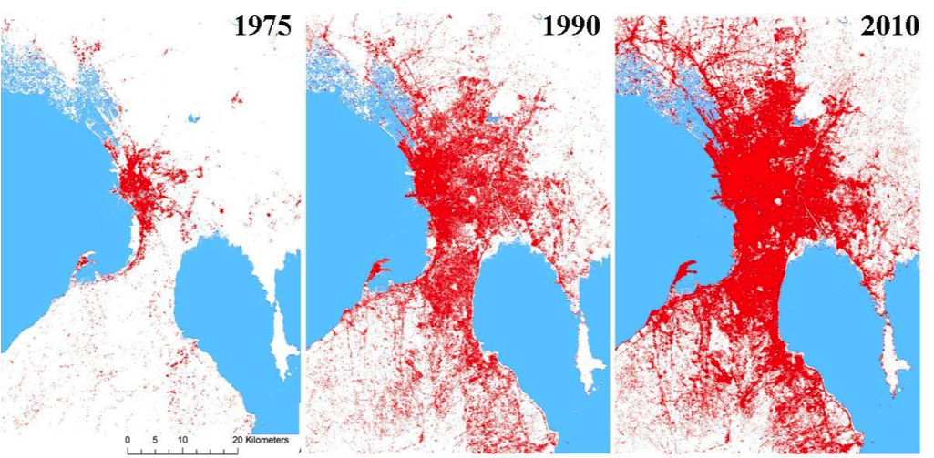
Research Areas: Change Detection
14
Notes:
change detection shows the changes over a period of time. In this example we see the changes within urban sprawl over several years
There are several ways to show change detection Whether it be "abrupt vs subtle" "human vs natural" or "real vs detected")
(Detect change of landscape over time.)

Slide 18
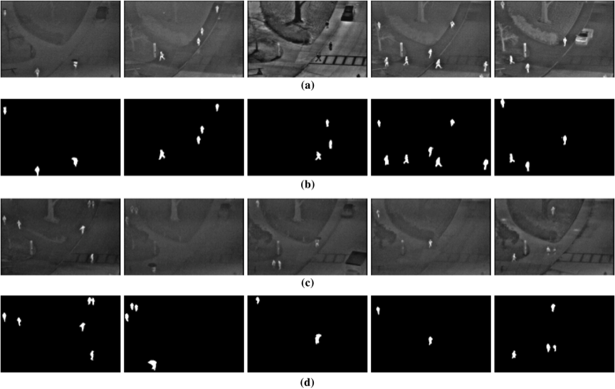
Research Areas: Target Detection
13
Notes:
and lastly,
Target detection: This is a specific thing you're looking for and is used to map feature locations with a particular spectral or spatial signature
(Used to map target or feature locations with a particular spectral or spatial signature.)
Spectral Unmixing:
(Provides information to monitor different natural resources. ie agriculture, forest, geological)

Slide 19
References
1. http://serc.carleton.edu/images/research_education/katrina/katrina.jpg
2.http://www.hurricanekatrina.com/levees-repaired-in-new-orleans.html
3..http://www.katrinadestruction.com/images/v/noaa_overhead_gulf_coast_aerial_images/katrina-new-orleans-la-4-08-31-2005c1.jpg.html
4. http://ee.stanford.edu/~zebker/images/ersgeometry_small.gif
5. http://www.qrg.northwestern.edu/projects/vss/docs/communications/1-what-is-wavelength.html
6. http://www.arete.com/arete_innovation/active_eo1.aspx
7.Ghttp://climatechangeminute.podbean.com/2012/04/23/four-resolutions-of-remote-sensing/
8. http://www.sciencedirect.com/science/article/pii/S0924271612001013
9.http://www.intechopen.com/books/biomass-and-remote-sensing-of-biomass/introduction-to-remote-sensing-of-biomass
10.http://www.nrcan.gc.ca/earth-sciences/geography-boundary/remote-sensing/fundamentals/1954
11. http://www.gdcanada.com/content/53ac10af-9e37-470f-a879-f28cd680b11f/20090331120814.cfm
12.http://www.learnremotesensing.org/modules/image_classification/index.php?target=image_class
13.http://opticalengineering.spiedigitallibrary.org/article.aspx?articleid=1568410
14.http://www.earthzine.org/2011/07/20/remote-sensing-%E2%80%93-an-effective-data-source-for-urban-monitoring/
15.http://www.gisdevelopment.net/technology/rs/techrs0020pf.htm
16.http://54961968.nhd.weebly.com/background-context.html
17.http://www.oneonta.edu/faculty/baumanpr/geosat2/RS%20History%20II/RS-History-Part-2.html
18.http://history.nasa.gov/SP-400/sp400.htm
19.http://www.strategic-air-command.com/aircraft/reconnaissance/u2_spyplane.htm
20.http://www.fas.org/irp/imint/kh12_2.htm
21. http://www.airships.net/zeppelins
22. http://teacheratsea.wordpress.com/tag/radar-scans/
Notes:
These are my resources and that is a basic understanding of remote sensing. you can now take the assessment to this powerpoint.

Slide 20
You can find more information at the following site
CERSER
http://cerser.ecsu.edu/

